Slide 1
SPECIFICATIONS
CREATION OF A WEBSITE
Name of the enterprise: Global Central d’Achat
Name of the project: Creation of a Website for Global Central d’Achat
Person to contact in the company: Mr. Mac Donald Kom,
Mr. NWINKOU Landry
Telephone:679 81 01 45
Email: nzinkoulandry@ifpac.net

Slide 2
PRESENTATION OF THE ENTERPRISE
Global Central d’Achat is one of the 6 services under the Global group that deals with the Import and Export of products
GLOBAL GROUP
Global travel and services
IFPAC
Global industry
Black and white love
Global central d’achat
Global Auto-Ecole

Slide 3



GLOBAL CENTRAL D’ACHAT
Global Central d’Achat is one of the 6 services under the Global group that deals with the Import and Export of products
The purpose of the Global Central Achat is to create an IMPORT/EXPORT link both in national and international territories
Take care of national and international finalities
Respecting delivery time

Slide 4
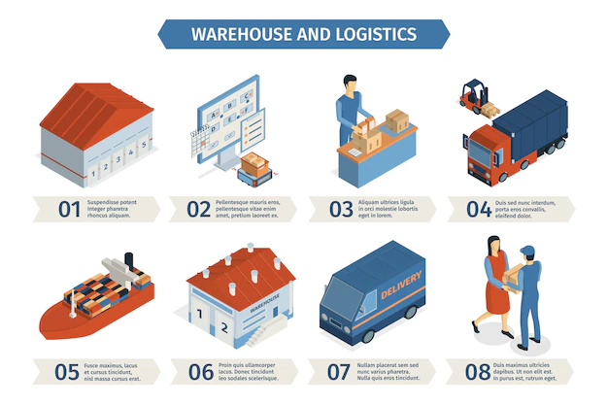

Slide 5
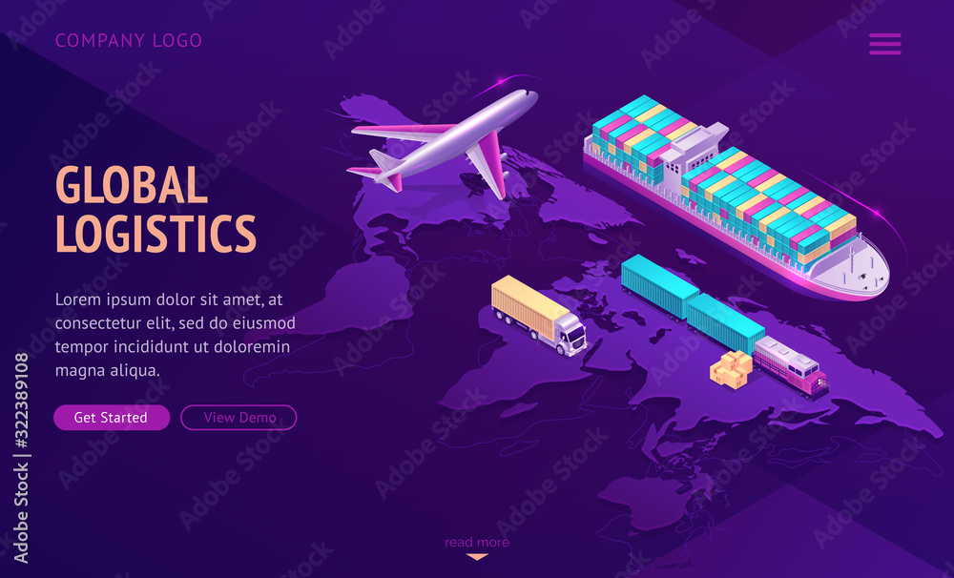
Budget

Slide 6
GLOBAL CENTRAL D’ACHAT
The purpose of the global central d’achat is to ease stress burden people face when they need to send and collect their product
TARGETED AUDIENCE
This project is targeted to the entire population
HOW THE SYSTEM WORKS
Global Central d’achat system stores the following information:
Imported/exported product Description, it includes the kind of products to be I/E.
The date of transaction,
Estimated time of arrival
Product code
Means of transportation
A tracking number will be sent when about to export the goods
Customers Description
It includes customers code, name, address, phone number, residence, email, and country of origin. This information may be used for keeping the records of the customer for any emergency or for any other kind of information.

Slide 7
User Class and Characteristics
The systems database should be able to retrieve data on transactions carried out by a client with the given time and date of the transaction. The system will support two types of users privileges, customer and employee. Customers will have access to customer functions and the employees will have access to both customer and global central purchasing functions. The customer should be able to do the following functions:
Login to the system
Reset user information
Place an order for export
Pay for services
Cancel a transaction
Carry out monetary transactions

Slide 8
The employee should have the following management functionalities:
Get all customers who have sent or received goods
Add/delete a transaction
Add a new functionality to the system
Calculate total transactions for a day
Get details of all products that are on time/delayed in delivery
Able to handle traffic in the system and fix bugs

Slide 9
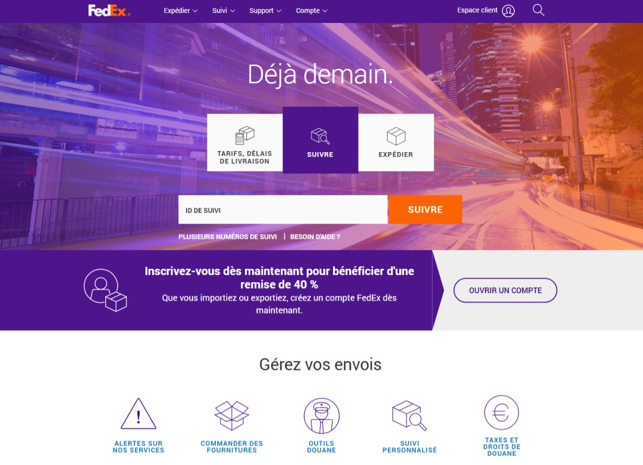

Slide 10
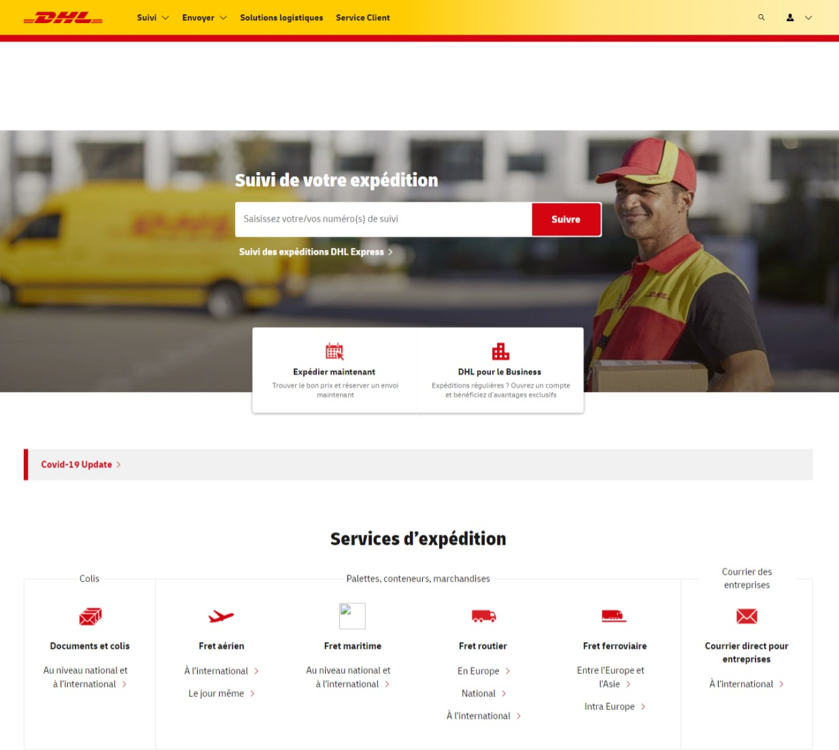

Slide 11
ANALYSIS OF THE EXISTING
Programming languages: HTML, CSS, JAVASCRIPT, PHP, MySQL, Python
Location of the enterprise: Melen
Number of people for the creation of website: 03 people
Operating environment : Operating system ; windows, Ubuntu, android, tablets and iOS.

Slide 12
Number of pages (04 pages}
Home page
Login page
Payment page
View his itinerary
Domain type: .COM (top domain name)
We are targeting the general public, a professional audience in general (businessmen) since they are the ones who mainly carryout transactions

Slide 13
NONFUNCTIONAL REQUIREMENTS
PERFORMANCE REQUIREMENT
The steps involved to perform the implementation of the site database include;
E-R diagram
This constitutes a technique for representing the logical structure of a database in a pictorial manner. This analysis is then used to organize data as a relation, normalizing relation and finally obtaining a relation database
Entities
-which specify distinct real world items in an application
Attributes
-which specify properties of an entity and relationships
Relationships
-which connect entities and represent meaningful dependencies between them.
NORMALIZATION
The basic objective of normalization is to reduce redundancy which means that information is to be stored only once.
Storing info several times leads to wastage of storage space and increase in total size of the data stored.
If a database is not properly designed, it can give rise to modifications anomalies, which can be eliminated by normalizing the database

Slide 14
PROJECT PERIMETER
Multilanguage website (English, French, etc.)
Online payment for transactions abroad
Online and physical payment for those in the country
Our website will have a mobile version
The client must create his or her account

Slide 15
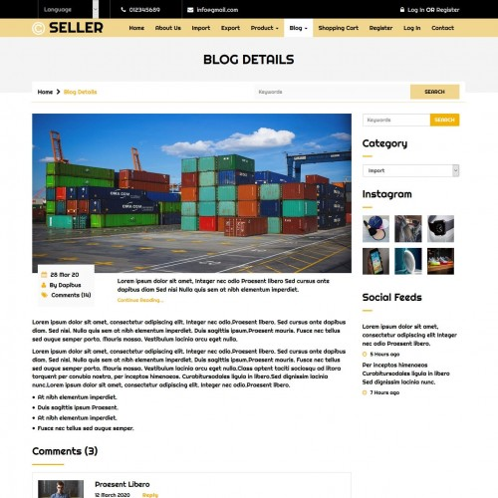
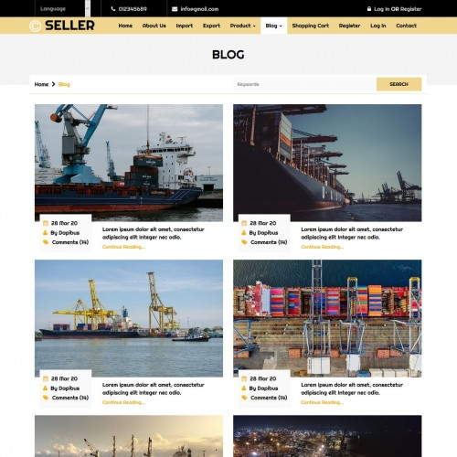
Graphics and Ergonomics

